Slide 1



Know your Worth
Career Focus
CodeClan Careers Team
www.codeclan.com

Slide 2
Before we begin...
Sometimes it is not YOU
Even with professional recruiters. The process has a subjective element to it and different recruiters look for different things
BUT
There are plenty of things you can do to increase your chances
We plan to help increase your chances this week

Slide 3
Looking Back- Inspiring Confidence Session
You covered...
Personal Branding
Your why and storytelling
Imposter Syndrome
We will be delving deeper into these themes but from a more career related focus.
Notes:
Remember doing this in week 3? We are going to be looking deeper into Personal Branding and Storytelling - l
We want to inspire the students to rethink why they came to CodeClan and to figure out their ‘WHY’ as people. How to brand themselves for interviews and think about what kind of company they are looking for and the flexibility they have when looking for a new career. Getting them to think about their CV Personal Statement

Slide 4
Ask yourself this...
If I had to describe my first impression in two or three words, I would say people see me as _____.
Notes:
Don’t need to share at this stage, ask them to think honestly.

Slide 5

If I had to describe my ideal first impression in one word, I would want people to see me as _____.
Notes:
Ice breaker task - ask students to answer this question. Open up a discussion about different personalities different motivations -link back to myers briggs personality test and talk about the importance of being self assured when it comes to interviewing/networking. Comment on although this is a silly question it is really a ‘storytelling’ question in a different format. We need to get better at talking about ourselves in a confident manner. This session plans to help do that.

Slide 6
How important are first impressions?
It is easier to confirm a positive first impression than to convert a negative impression into a positive one
Notes:
Stats show that first impressions are determined by
55% - of focus is based on appearance (the way you dress/act)
38% - tone of voice, confidence in your voice
7% - on the actual content of what you are saying

Slide 7

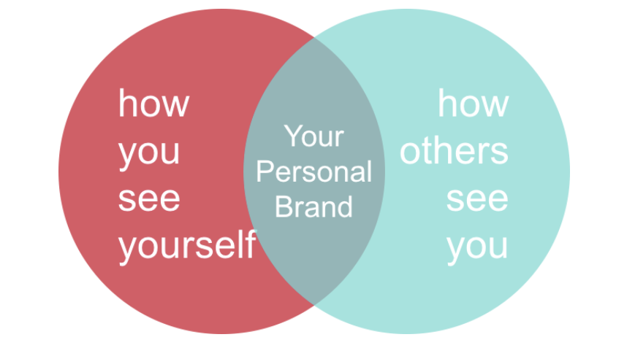
What’s your candidate differentiator?
What makes you stand out?
Why should people want to work with you?
Notes:
Personal branding is more than just a 30-second elevator pitch used to introduce yourself. While it is important to quickly and concisely explain who you are and what you can bring to the table, personal branding goes much deeper than that.

Slide 8
Think about the people YOU admire
What makes them stand out?
Why do you think people should admire them?
Notes:
Feedback - ask them to think of people they know personally - maybe they were bosses, friends, family or colleagues.
Try to get a discussion going about different types of individuals. Use the chat function to ask them to use descriptive words. The aim of this exercise is to highlight to them that there is no ‘ideal person’ people stand out for a variety of reasons but they all share one thing in common - ‘confidence, or at least, acceptance in themselves.
In order to do that you need to be self aware. This means been confident in your abilities and accepting of your limitations and willing to develop them. This session will involve self-reflection. This is easy for some who are used to it but can be difficult for others. It is a useful skill to develop on as throughout your career you will be required to reflect on your performance and behaviours. Getting into the habit of doing this now will help you during interviews as interviews are specifically designed for you to reflect on your experiences.

Slide 9
Know YOUR Worth
Emotional Intelligence is Key to Career Success
Why?
You learn to recognise your strengths and circumstances that promote them
You learn Identify triggers for stress Best way to improve your EQ is to self reflect and interact with individuals who have opposing views to you
Notes:
This session will involve a lot of career coaching techniques to help you to reflect on your career to date and build confidence/awareness on what lies ahead. The 3 questions on the slide are 3 of the more common questions that career changers struggle with. We will tackle each statement throughout this session.

Slide 10
Know your Worth
Today's session aims to tackle these questions
How can I make sense of my career so far?
What do I want from a job?
I want to go for it but what if I am not good enough?
Notes:
This session will involve a lot of career coaching techniques to help you to reflect on your career to date and build confidence/awareness on what lies ahead. The 3 questions on the slide are 3 of the more common questions that career changers struggle with. We will tackle each statement throughout this session.

Slide 11
How can I make sense of my career so far?
Make a note of 3-5 things that inspired you to come to CodeClan. Think about:
What motivates you to start this new career?
What are your intentions, goals or drivers?
What are your areas of interests?
What do you want to learn more about?
Is there a sector or area of specialism you’d like to work in?
If you are struggling with positive inspiring comments try answering the questions on the following slide…
Notes:
Explain task - before you can move forward you need to know where you are coming from.
Take a few minutes to jot down some answers to the following questions.

Slide 12
How can I make sense of my career so far?
Who did you admire when you were growing up?
Do you subscribe to or regularly read any magazines?
Currently, what is your favourite story from a book or a movie?
What is your favourite saying?
What are your earliest recollections?
Employers value your motivators to change career, in other words, your why...
Notes:
Explain task - before you can move forward you need to know where you are coming from. Theorist Savickas (2009) came up with 5 career construction questions that help individuals to make sense of their lives and help them tell their stories. This framework can help you to construct the foundations for your storytelling brief, in other words, YOUR WHY. We will now watch a video which describes how powerful this method of storytelling actually is.
This can be done in pairs if the group is large or quiet and need to engage or it can be done individually. Will depend on the energy of the group.

Slide 13
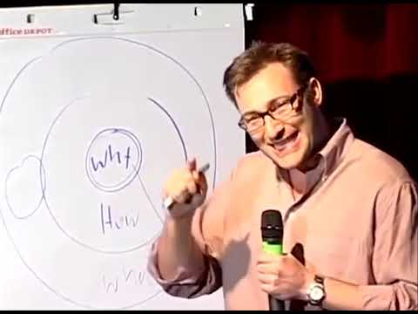
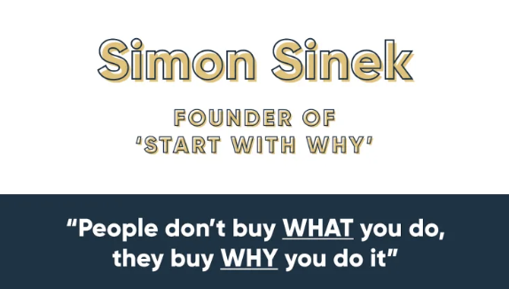
How can I make sense of my career so far- Your Why?
Notes:
Look back at your motivators and ask yourself what is your ‘why’? This will form part of your homework tonight. Think back to the questions on the previous slides. You are looking to paint the listener a picture of who you really are, what makes you ‘tick’. Stating facts and impressing people with your qualifications is not going to grip them but your ‘WHY’ might…

Slide 14
Your Unique Selling Point
Why do you believe you should get this job?
Make a list of 10-15 skills that you are confident that you have and can evidence.
Notes:
Once you have figured out your WHY you want to discuss your USP. What sets you apart from everyone else on this call? Give the group 3 or so mins to do this task.

Slide 15

Hard Skills vs Soft Skills
Think about your own personal toolkit: One side has your hard skills - the other has your soft skills. Proving your tech is important - but getting a job is largely about soft skills. What’s in your toolkit?
Notes:
Ask the group to look back at their lists and to split them into soft and hard skills. Remind them that soft skills are just as important, if not more important, than hard. As they are more difficult to teach. As codeclan graduates this is the single more important factor that sets you apart from other graduates. Your soft skills are what makes you desirable to them. Own it.

Slide 16
Your Unique Selling Point
Soft skills are the skills that make you uniquely human.
They are harder to evidence which is what makes them so valuable and essential to talk about during interviews.
They are often referred to as competencies
Notes:
We will discuss competencies in our interview workshop session.

Slide 17

How can I tell the story of my career?
It’s so important to be able to confidently talk about yourself
You will need to come up with a 3 minute ‘about you story’ -- why you want to do this as a career? Why would you fit in the company or want to work for that company? How your experiences suit what the company is looking for -- or why they need you!
Notes:
THINGS TO MENTION:
That time when we stop getting a quiver in our voice when we are presenting or talking to someone new, is when we know our story.
Good public speakers always start with a story.
It takes 6 seconds for our nerves go away.
It takes 90 seconds for someone to make a judgement of you.
When we are networking, we are looking for someone to match our story, someone who is similar to us and who we share similarities with.
Most people remember you by your story.

Slide 18

Developing Your Story - What to include?
It’s important to be able to talk about yourself, use this structure
Why development/data? Where have you came from? (career summary, interests) What is your unique selling points (skills you are confident in) Why you?
What to include:
your background - employers care about this!
your career motivations & goals
your interests
why you want to be involved in the industry
Your skills, what are you really good at?
Notes:
This is a useful structure you can use to help you form your story. Notice that we are suggesting you start with your ‘why’ but also finishing with a ‘why’. You want the listener to remember you and remember that you are passionate. Feedback from interviewers hiring juniors from CC will comment on attitude/passion as a reason to hire or not hire someone.

Slide 19

What do you want from a job?
Notes:
What is important when looking for a job? Do you want it to be 5 mins down the road? Do you want to work for a company that offers training & development? Benefits? Corporate or start-up?
MAP out the differences between what a start-up vs SME vs corporate company can offer a person.

Slide 20

What do I want from a job?
What led to job satisfaction in the past?
List items from worst to best.
Focus on personal experience and not objective job satisfaction like pensions/salary etc.
What really made you get up in the morning or smile at work.
Notes:
We want to inspire the students to rethink why they came to CodeClan and to figure out their ‘WHY’ as people. How to brand themselves for interviews and think about what kind of company they are looking for and the flexibility they have when looking for a new career. Getting them to think about their CV Personal Statement

Slide 21
7 Factor Job Satisfaction Model
(Roelen, Koopmans & Goothoff, 2008)
Task Variety
Colleagues
Working Conditions
Workload
Autonomy
Educational and Developmental Opportunities
Congruence (compatibility)

Slide 22
7 Factor Job Satisfaction Model
(Roelen, Koopmans & Goothoff, 2008)
What does your job satisfaction list include?
List from priority level

Slide 23
Draw three circles and try to think about your past, present and future.
Arrange the circles on the page to suit where you are and how you feel.
Answer the following questions
What were you thinking about as you drew the circles?
What do their relative sizes mean to you?
Describe a recent choice you have made and identify the time zone you focused on while making the decision
Use 3 words to describe how you feel about your past. Present and future
Define work and play. Compare and contrast them
How will your future adult life be different of that from your parents?
How will it be different from now?
Notes:
We want to inspire the students to rethink why they came to CodeClan and to figure out their ‘WHY’ as people. How to brand themselves for interviews and think about what kind of company they are looking for and the flexibility they have when looking for a new career. Getting them to think about their CV Personal Statement

Slide 24
Homework
Make a list of your soft skills and previous experience and how they can add value to a business or team - this is part of your value add (10-15min).
Think about using these to prepare 2-3 sentences that can summarise you in the style of a CV opening personal statement - i.e. whose CV are they reading?
It’s important to have a strong & individual CV / LinkedIn profile statement to introduce yourself and your achievements / offering.
It should describe your skills, motivations and show your individual intentions and personality.
Tell the reader who you are and what you offer them.
Notes:
Get them to write these sentences and keep them to themselves. This can be used as part of their personal statement for their CV or for LinkedIn. Ask if anyone is comfortable in sharing what they’ve wrote. Encourage them to be proud of who they are and what they think – there is no wrong or right answer.

Slide 25
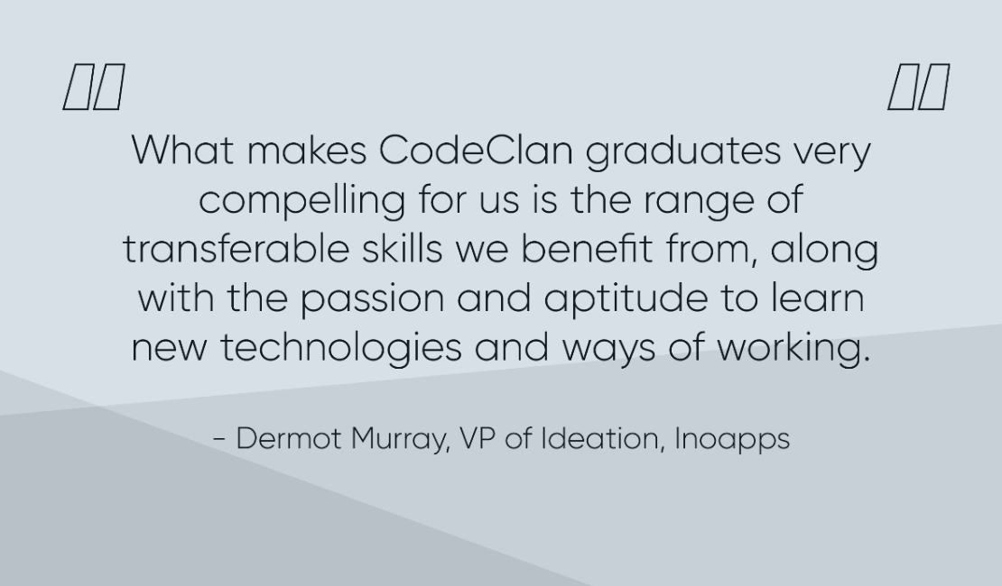
CodeClan Employers: Inoapps are a great example

Slide 26

www.codeclan.com

